Slide 1
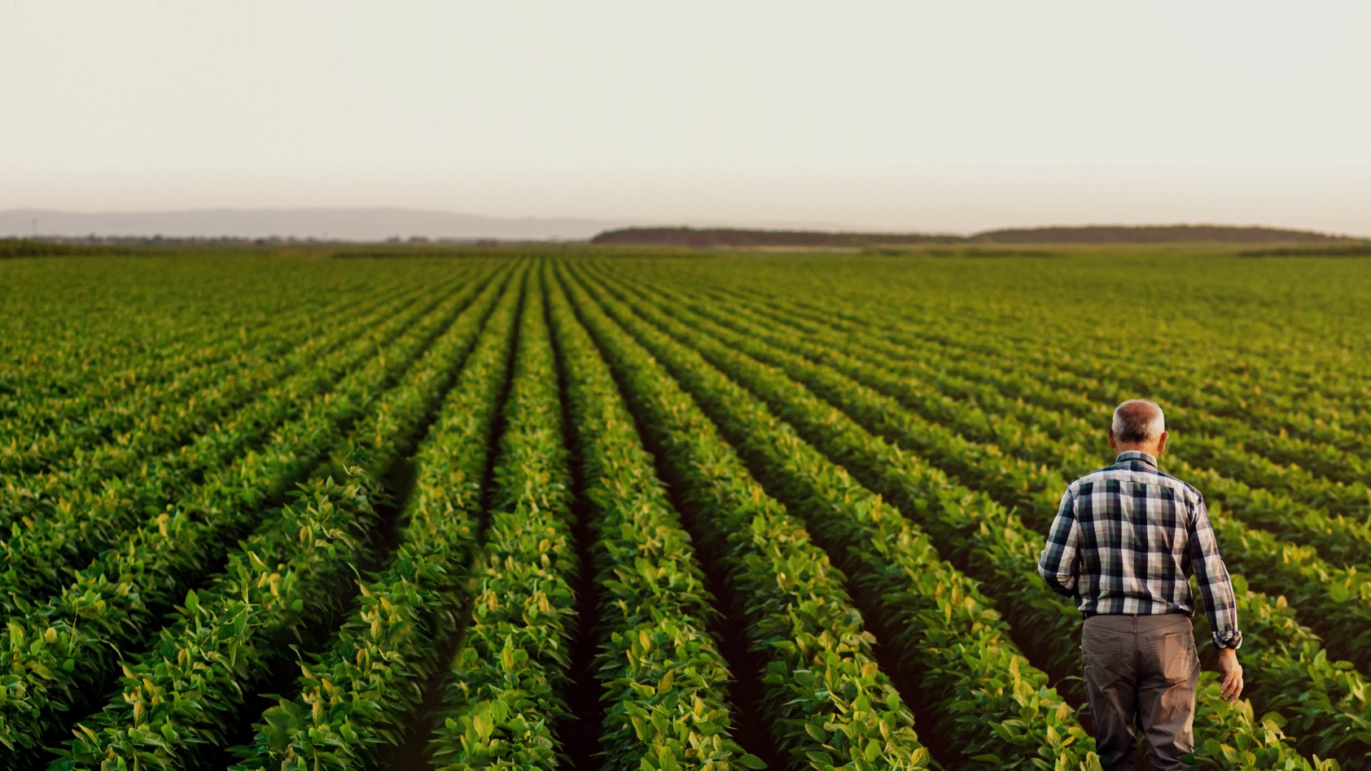
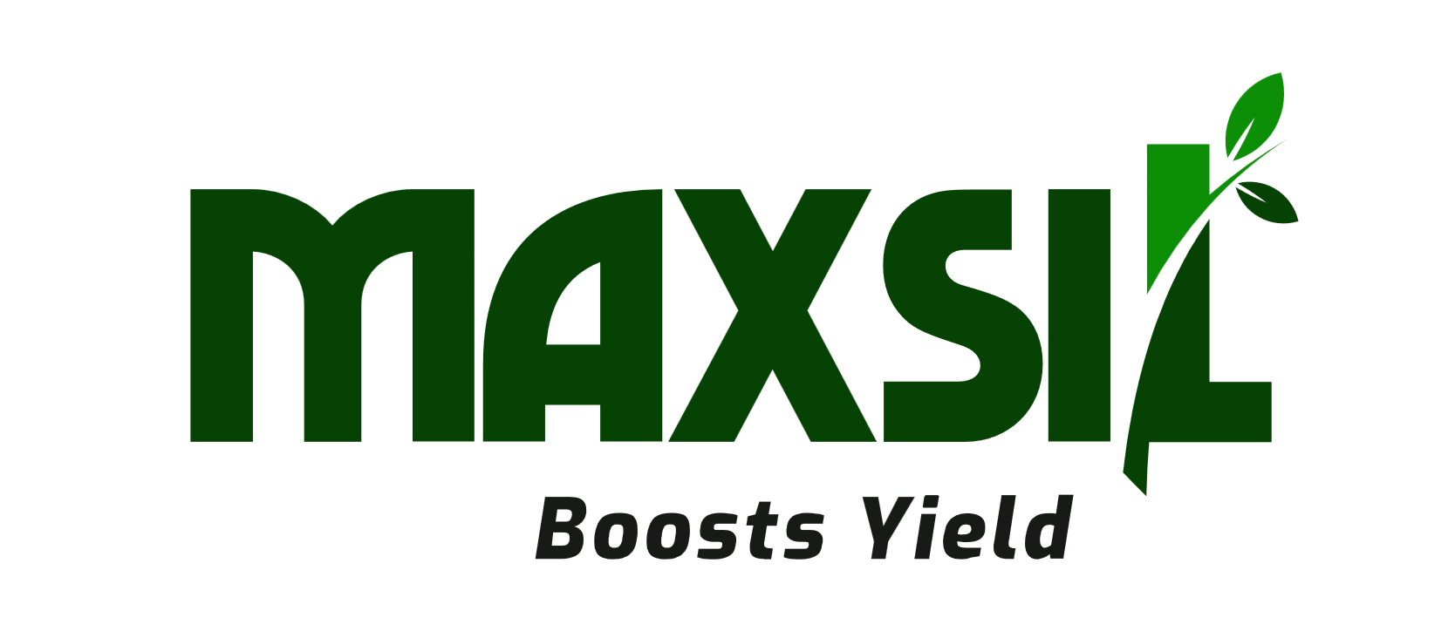
Turns Glass to Gold
JULY 2025
Notes:
FIRSTLY, THANK YOU FOR YOUR TIME……… I’M DELIGHTED TO BE HERE
MAXSIL DOES TURN GLASS INTO GOLD ---- AGRICULTURAL GOLD THAT IS, BUT GOLD NONE THE LESS

Slide 2

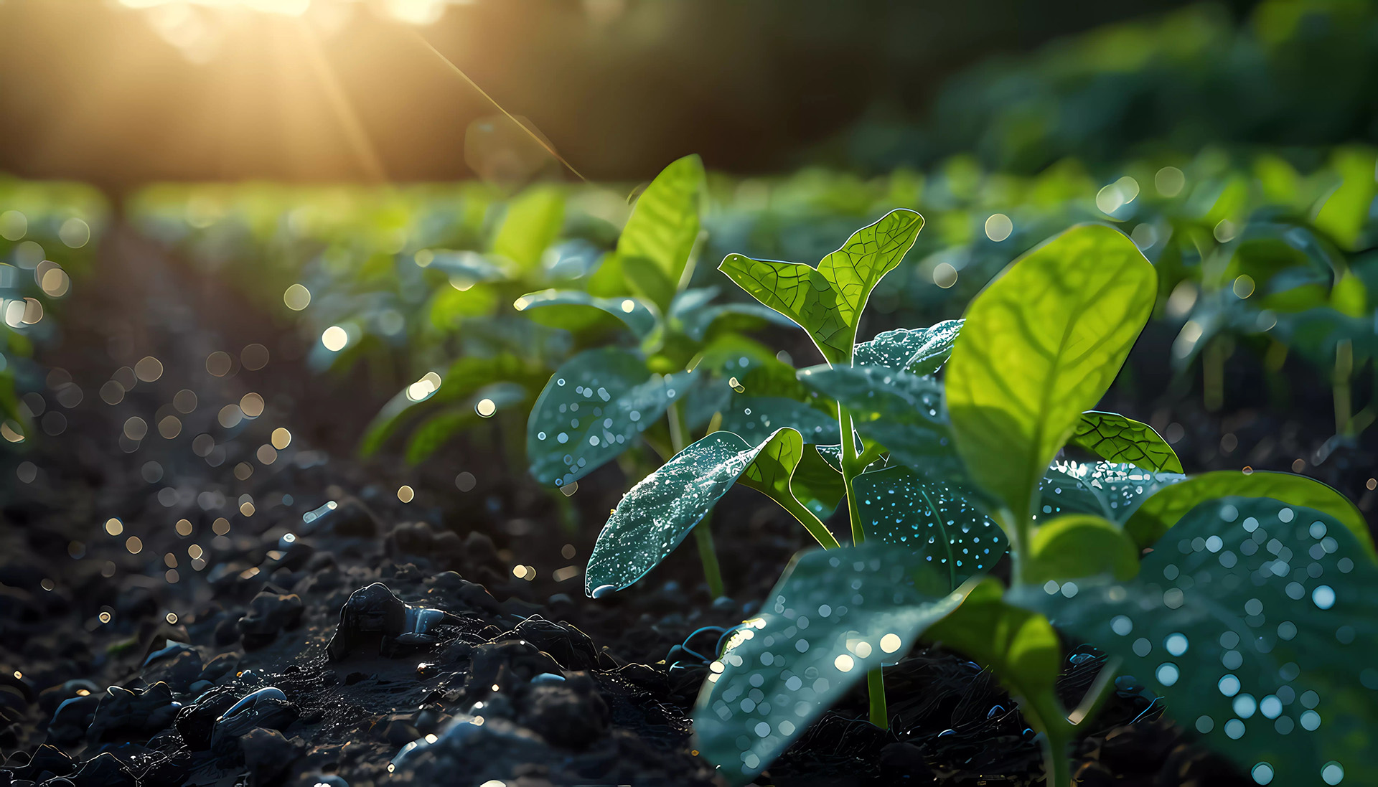
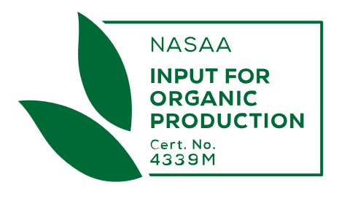
Glass = High Levels of Amorphous Silica
Amorphous Silica Forms Plant Available Silica
Si(OH)₄
Notes:
HOW DO WE DO THIS?
GLASS HAS HIGH LEVELS OF AMORPHOUS SILICA WHICH CONVERTS TO SIOH4, A FORM OF PLANT AVAILABLE SILICA OR “PAS”

Slide 3
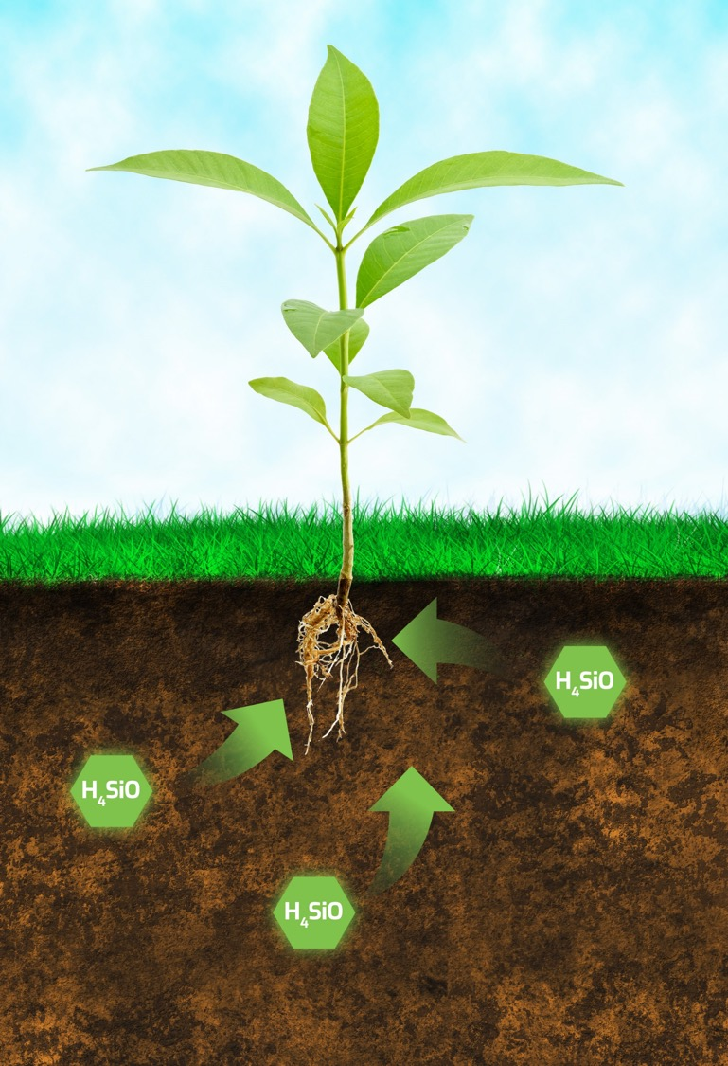

The Power of Plant Available Silica (SiOH4) or “PAS”
HIGH PAS LEVELS
INCREASE NUTRIENT UPTAKE
ENHANCE ROOT GROWTH
PROMOTE HIGHER YIELDS
IMPROVE QUALITY
Notes:
PAS PROVIDES A HOST OF BENEFITS TO PLANT LIFE INCLUDING INCREASED YIELD, STRENGTH AND QUALITY.
HIGH PAS IS THE MEASURE OF AN EFECTIVE SILICON BASED BIOSTIMULANT

Slide 4
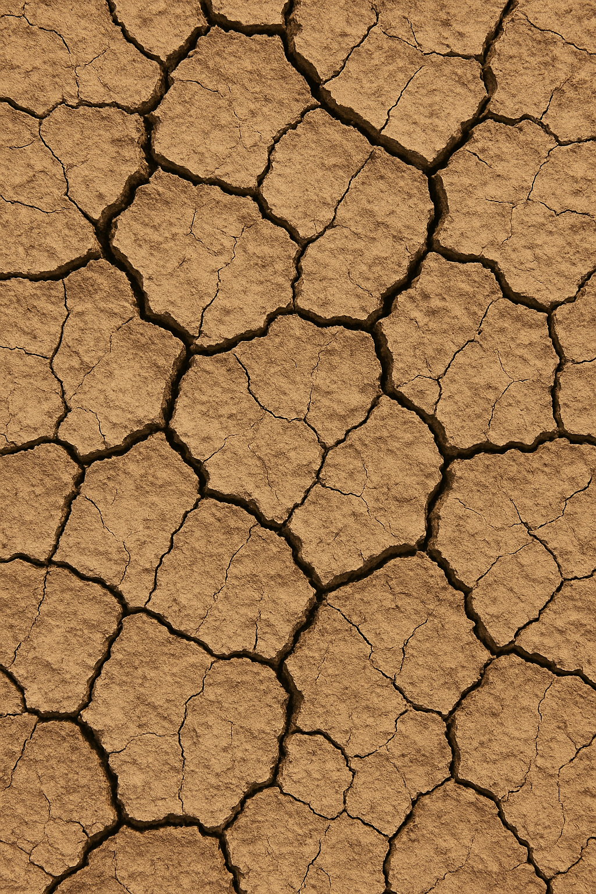

A Crisis of Land and Waste
Saline and Acid soils affect 1 billion hectares Globally
This leads to decreased agricultural productivity
And …..Millions of Tonnes of Glass Waste is choking landfills
Glass takes more than a Million years to degrade
Notes:
HOSTILE SOILS DRIVE PRODUCTIVITY DOWN.
COUPLED WITH THIS, GLASS WASTE IS CHOKING OUR LANDFILLS AND TAKES OVER A MILLION YEARS TO BREAK DOWN

Slide 5
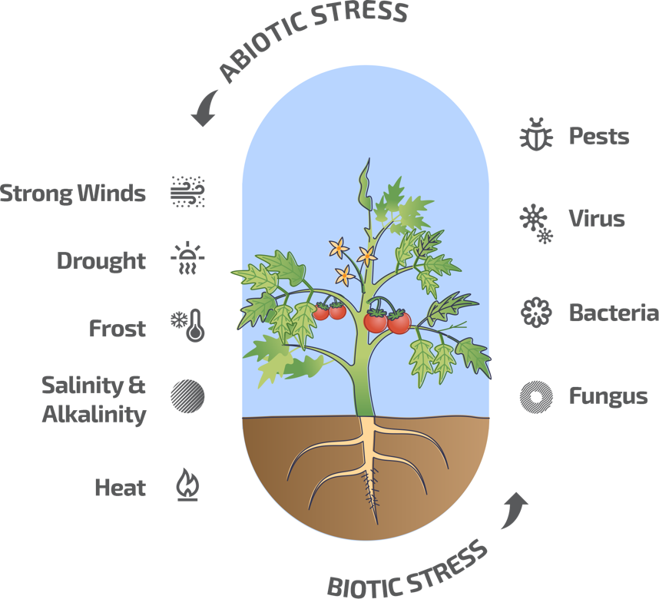
What make MaxSilTM Different?
UNMATCHED POTENCY Up to 42,000 ppm of Plant Available Silicon (PAS) - 40x more than solid competitors
CIRCULAR ECONOMY MaxSil™ transforms landfill glass into regenerative crop nutrition
EXCLUSIVE SOIL REGENERATION Only MaxSilTM is proven to regenerate saline and acidic soils – no other product comes close
HIGH ROI Lower dose rates Proven field results Patents granted across 3 continents —7 nations and counting
Notes:
MAXSIL IS EXTREMELY POTENT. IT’S THE ONLY COST EFFECTIVE SILICON BIOSTIMULANT THAT’S PROVEN TO REGENERATE AND REMEDIATE HOSTILE SOILS UNDER REAL LIFE CONDITIONS.
IT IS EFFECTIVE ACROSS ALL SOIL TYPES

Slide 6
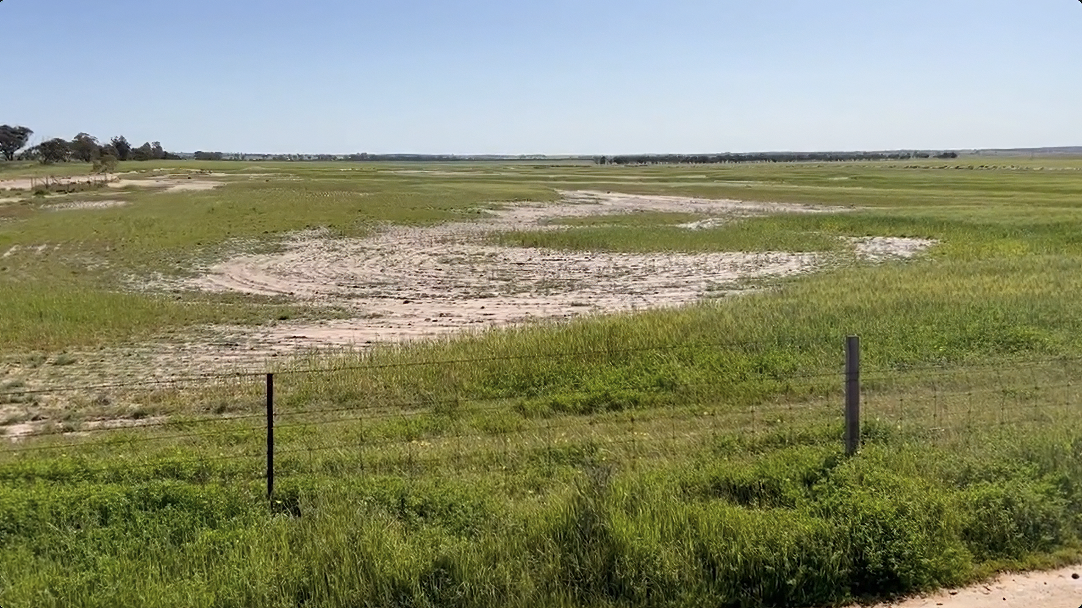
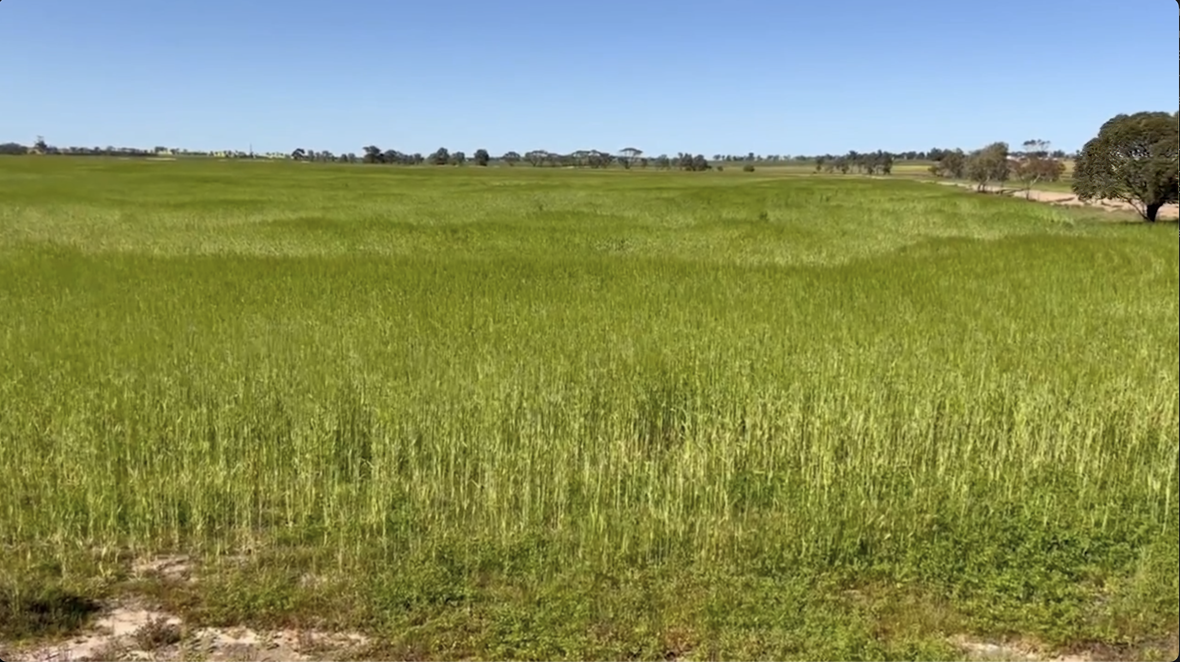
Real World Results
Before
After
“This land had not produced a crop in over 50 years. After applying MaxSil, we harvested a viable barley crop”
Claire Stevens – 4th Generation Cereal Farmer
Salt-Affected Land – Zero Production
MaxSil Treated Land – Viable Barley Crop
Land value was increased by up to $7,000 per Hectare
Previously Unproductive – Land Value Zero
Notes:
THIS IS AN EXAMPLE OF LAND THAT WAS PREVIOUSLY WORTHLESS BEING REBORN
WE HAVE SIMILAR RESULTS ACROSS SALINE SOILS IN WESTERN AUSTRALIA, SOUTH AUSTRALIA AND THE RIVERLAND AREA OF VICTORIA

Slide 7
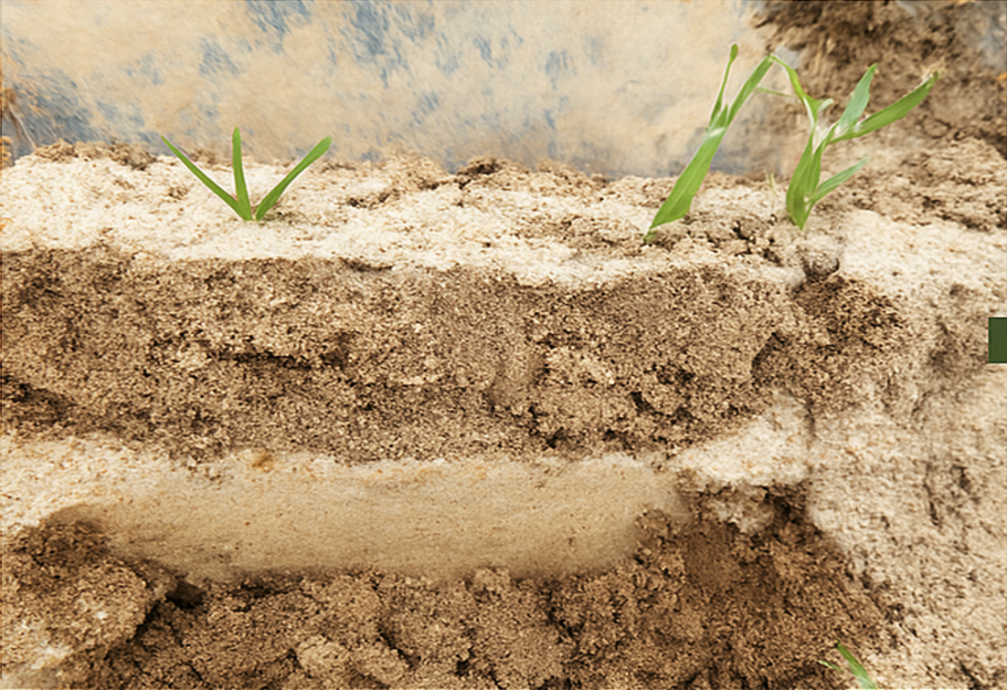
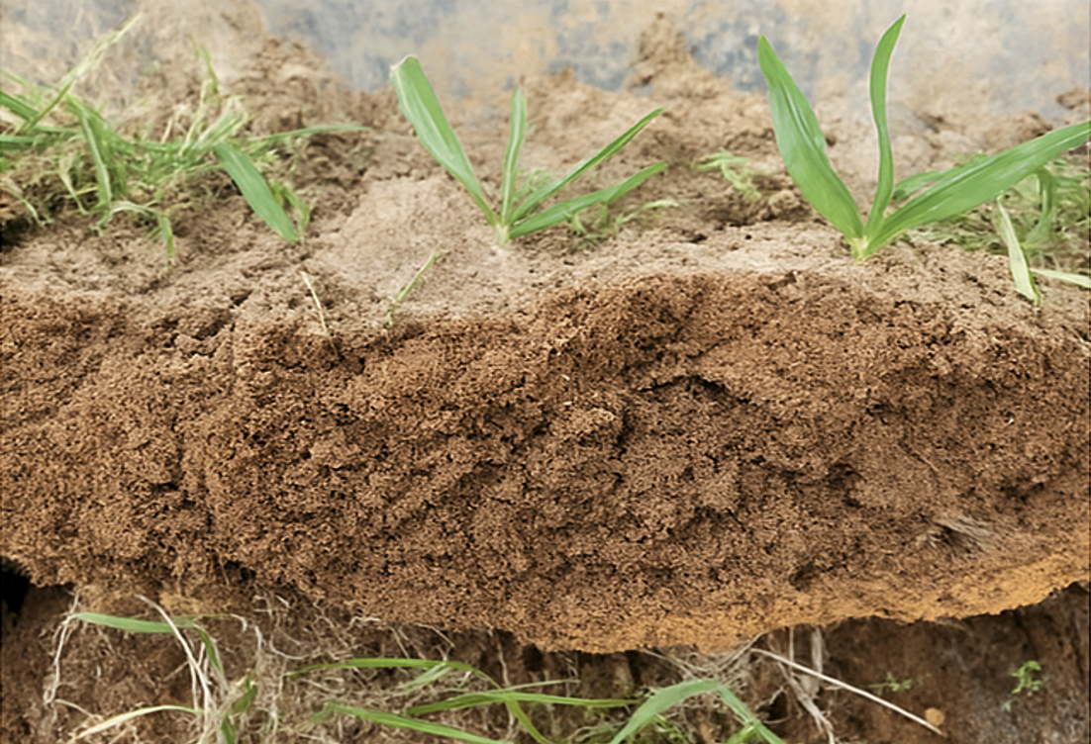
Soil Profile of the Crop shown on the Previous Slide
Limited Root Growth in Untreated Soil
Enhanced Root Growth with MaxSilTM
Notes:
NOW, IT’S A GIVEN THAT CROPS GROW FROM THE ROOTS UP. THESE PHOTOS DEMONSTRATE THE CHANGE IN THE SOIL PROFILE IN THE CROP SHOWN ON THE PREVIOUS SLIDE

Slide 8
10 Years of Validated Results – A Small Sample
“MaxSil is an excellent source of plant-available Si, and its application is beneficial to crop growth, yield, and quality”
PROFESSOR ZED RENGEL, A LEADING GLOBAL SOIL SCIENTIST
BARLEY on SALT AFFECTED LAND 14% Western Australia (Growers and Kalyx Australia)
MAIZE 20% Queensland (University of Queensland)
TOMATO >20% (No N) Colombia (Didesagro Pn Sas)
SUGAR CANE 33% Queensland (Tully Sugar LTD)
AVOCADO >30% Queensland (Grower)
CAPSICUM >25% Queensland (Kalyx Australia)
GRAPES >25% Tasmania (Grower – Lee’s Orchards)
Notes:
OUR RESULTS FROM TRIALS AND COMMERCIAL CROPS ARE OUTSTANDING AND THE COMMENT FROM A PROMINENT SOIL SCIENTIST WHO REVIEWED OUR 10 YEARS OF TRIAL AND COMMERCIAL CROP DATA IS WORTH NOTING

Slide 9

MaxSil’s Addressable Markets
5 BILLION HECTARES OF CROPLANDS
1 BILLION HECTARES OF HOSTILE SOILS
Notes:
SO, OUR POTENTIAL MARKETS ARE CROPS GROWN ON NOT ONLY HOSTILE SOILS BUT CROPS ACROSS ALL SOIL TYPES
WE ARE AWARE OF POTENTIAL FOR CARBON SEQUESTATION WITH A QUALITY SI BIOSTIMULANT BUT WE HAVEN’T EVEN BEGUN TO ADDRESS THAT MARKET

Slide 10
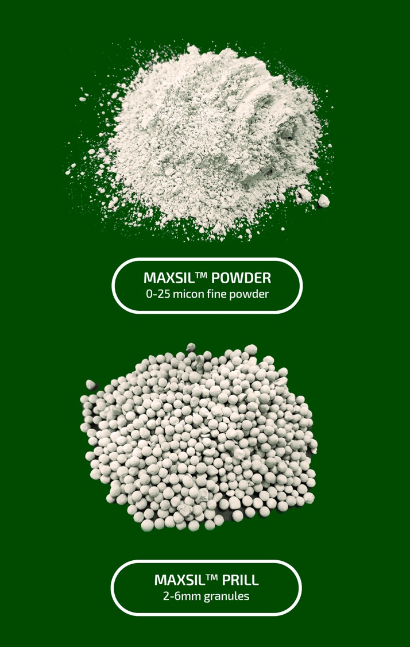
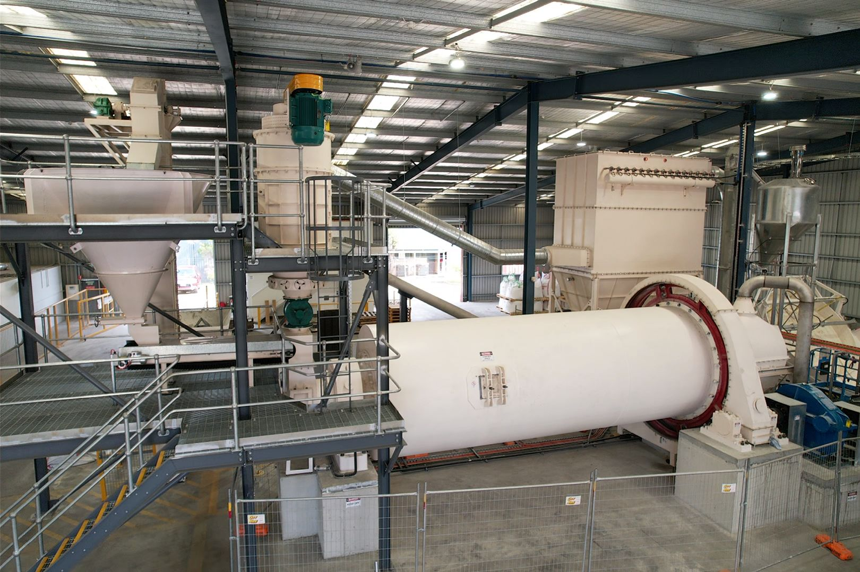
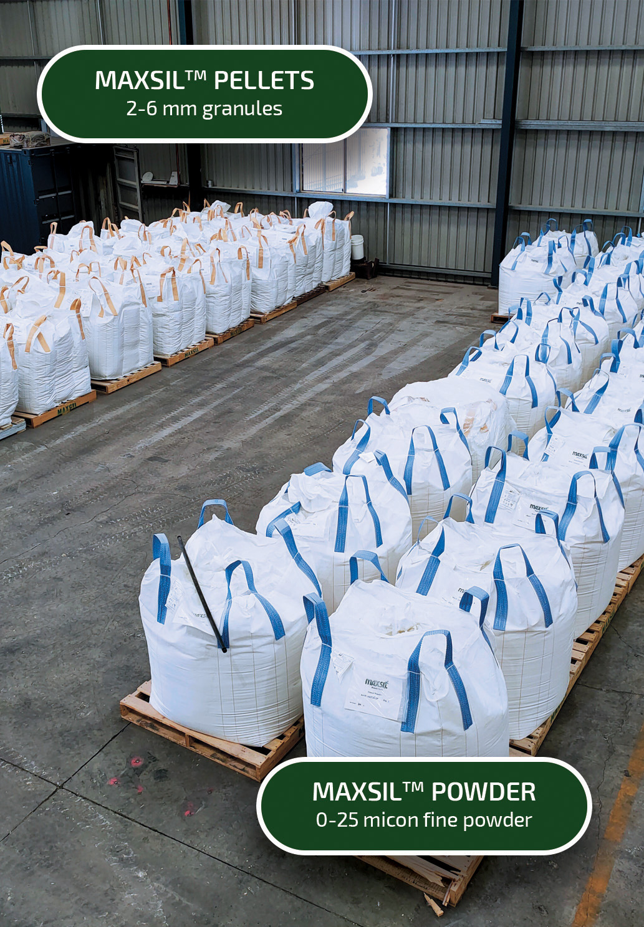
MaxSil’s Manufacturing Plant
Produces Powder and Granules
Notes:
HOW DO WE MAKE THIS PRODUCT?
THE PHOTO DEPICTS OUR MANUFACTURING FACILITY IN BRISBANE. THE TECHNOLOGY AND KNOW HOW ARE TRANSFERABLE

Slide 11
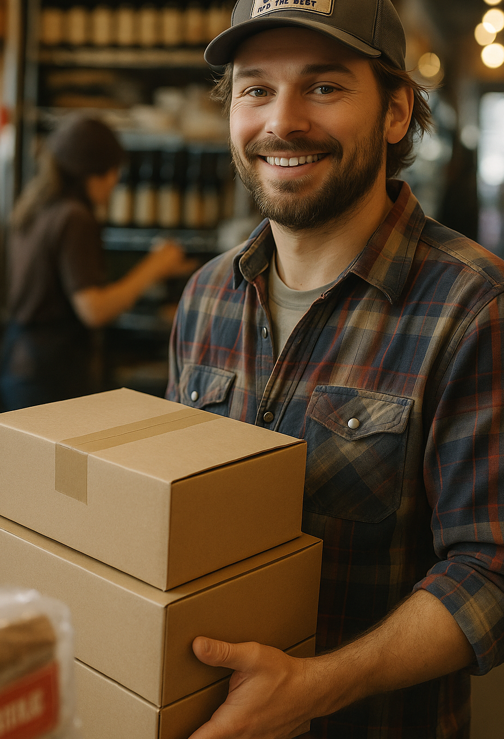
Distribution
Product available at major Farm Suppliers Australia Wide
Trials underway in Brazil, Thailand and Germany
MOU being executed with global phosphate producer
Possible JV operation in Vietnam
Notes:
WE DISTRIBUTE NATIONALLY VIA ESTABLISHED FARM SERVICE PROVIDERS
AND TRIAL WORK IS UNDERWAY ON UPLAND RICE, MAIZE AND GRAPES AROUND THE WORLD

Slide 12

MaxSil’s Global Readiness
MaxSil is poised for global partnerships.
Our vision is to scale operations worldwide with like-minded partners
Our solutions are effective across diverse agricultural markets.
david@maxsil.com.au | www.maxsil.com.au
Notes:
WE ARE READY TO SCALE
THANK YOU FOR YOUR TIME AND PLEASE REACH OUT WITH QUESTIONS AT ANY TIME

