Slide 1





Biologicals transform agriculture
A joint venture with

Slide 2

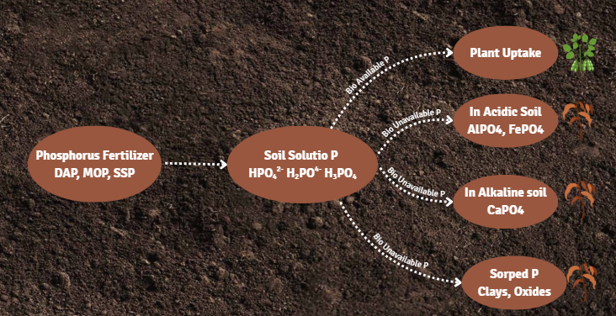

Problem Statement
🌍 Acidic soils - 3.95 billion hectares, which is 30% of the world's ice-free land. Salinity stress affects nearly 954 million hectares of land.
❗ Both conditions severely limit plant phosphorus uptake, affecting productivity and sustainability in agriculture.
33% of global soils are degraded
>60% soils degraded in Asia and Africa.

Slide 3

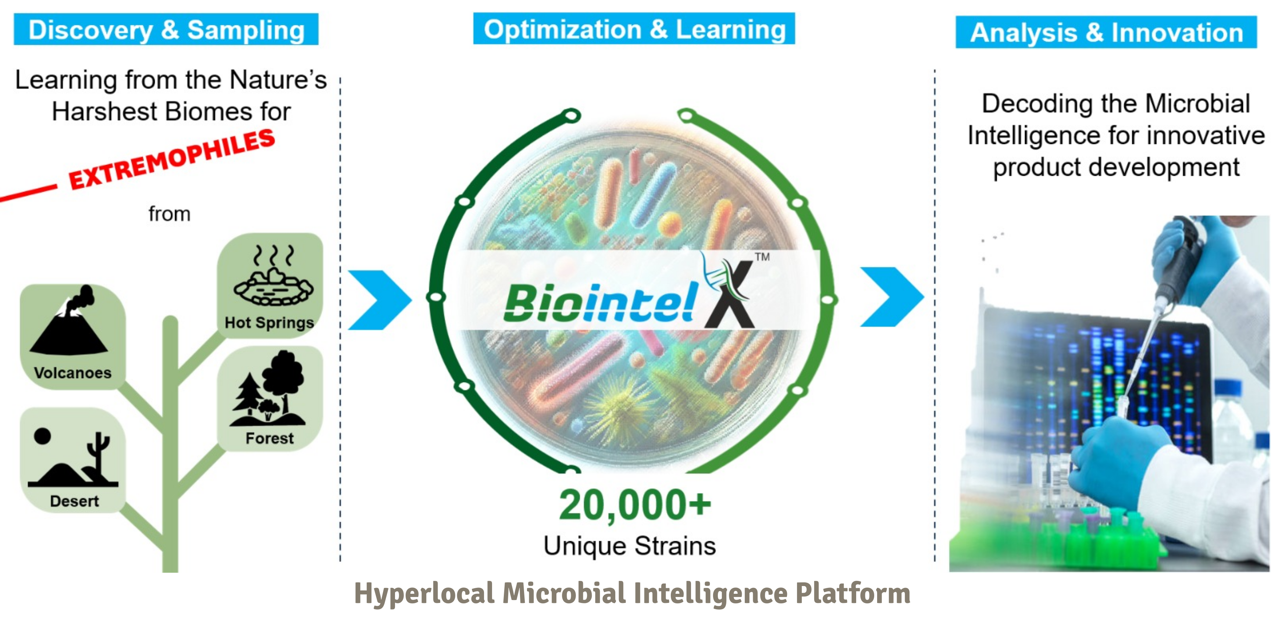
Our Solution
Microbiome & metabolite platform

Slide 4
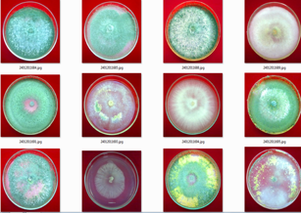
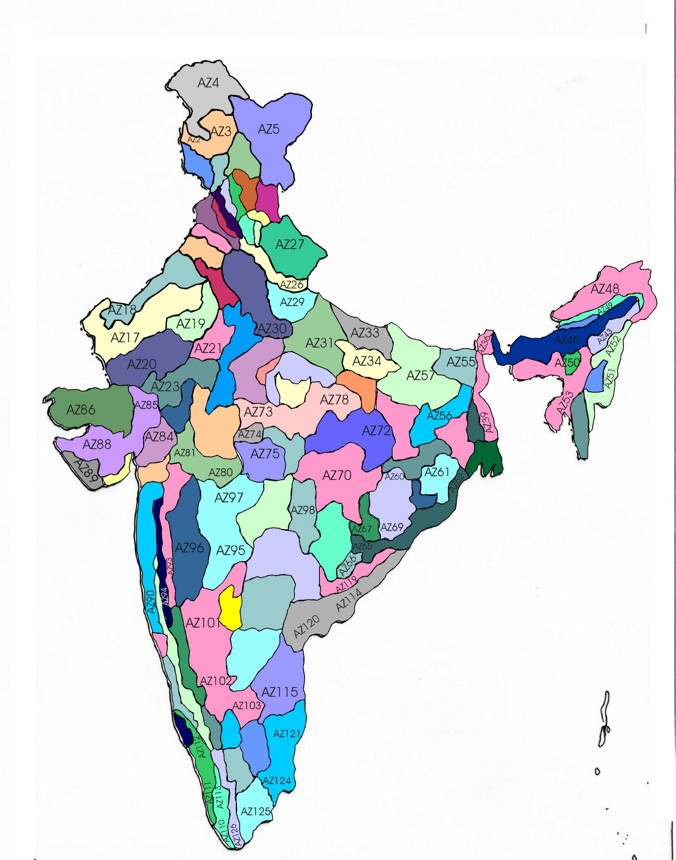
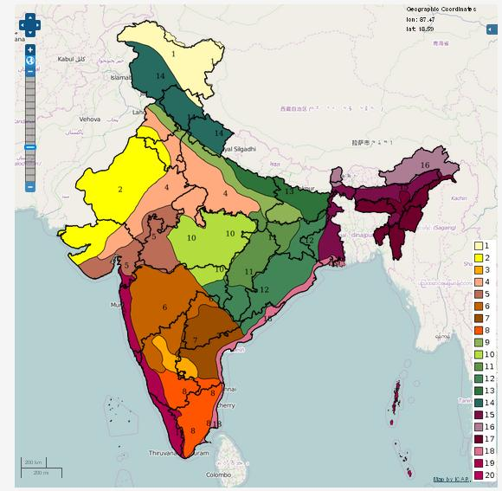
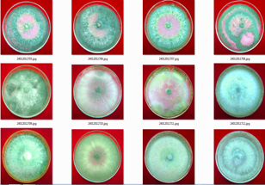
Eco-friendly microbial culture Bank: Upholding of Real Natural Wealth for sustainability
3000+ screened & characterized for potential agriculture applications; Culture type collection covering
127 agro climatic zones
20 ecological zones
62 soil types
Alakaline, Acidic, Humus rich, Sulphur rich, marsh lands
T-1 T-2 T-3 T-4
T-5 T-6 T-7 T-8
Syn pda
T-9 T-10 T-11 T-12
T-13 T-14 T-15 T-16
T-17 T-18 T-19 T-20
T-21 T-22 T-23 T-24
Culture deposition – based on activity and novelty, Metabolomic and Genomic studies were conducted

Slide 5

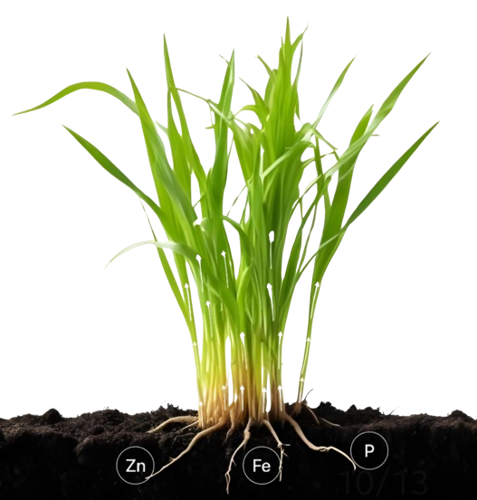






Case study:
Effect of Penicillium pinophilum NFCCI 2498 on nutrient use efficiency and grain yield in Paddy
Grain yield (kg/ha)
P use efficiency (kg/kg)
N use efficiency (kg/kg)
2X
Increase in Dry Matter
K use efficiency (kg/kg)
7780
25.17
6480
20.41
20%
Increase in Yield
15.46
11.97
10.23
6.03
40%
Increase in Root Volume
Conventional Fertilizers + BF
Penicillium pinophilum NFCCI 2498
K
N

Slide 6

















Milestones
Working with largest farmers cooperative Access to 45000+ outlets India & Africa
Research funding by Grant
Validation in India and Brazil
Indian Startup Award winner for Agriculture impact
Validation in EU & Africa
2021
2022
2023
2024
2025

Slide 7








Potential Impact by 2027
3 Lakh Ha land area impacted
5Lakh Farmers Benefited
$
Reduction in Fertilizer 19500 MT Urea;
13500 MT of P&K
1.3 Billion Rs. saved on fertilizer subsidy
We meet 5 SDGs
23.1 Billion Lit of irrigation water saved
0.55 M MT of CO₂ equivalent emission reduced
60% Reduction in pesticide usage
1.12 Billion $ additional revenue to farmers

Slide 8
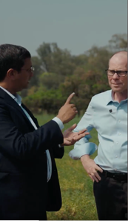
Interaction with Mr. Bill Gates and Mr. Mark Suzman, CEO, Gates foundation
About FUNDING the NEW TECHNOLOGIES

Slide 9








Team Capsber
CORE
Dr. Priti Khalkho
Founder
STRATEGY
Mr. Manoj Kumar R
Founder
BUSSINESS
Mr. Gavaskar J
Co-Founder
PRODUCTION
Dr. Prabu Pandian
Production Head
PhD Agri Biotech
14 years
Publications: 12
MS Agri Biotech
16 years
Patents:2 Product:5
MSc Bioinfo
15 years
Patents/Product:7
PhD Microbio
14 years
Publications: 10
CALIBER
10+ years of experience & expertise
PASSION
Farmer oriented
VISION
Impossible is possible
Employees : 75 Technical : 26 Field & Nontechnical :49

